Slide 1
Project Presentation
Honda Virtual Assistant
Sponsor: Amol Govindwar
Member: Jiankai Xu, Jason Xu, Jeremy Lin

Slide 2
CONTENT
Introduction
What has been done?
Bot Framework Analysis
Decision Making
System Architecture
Project Handoff
What’s next
Risks & Measures
Demonstration

Slide 3
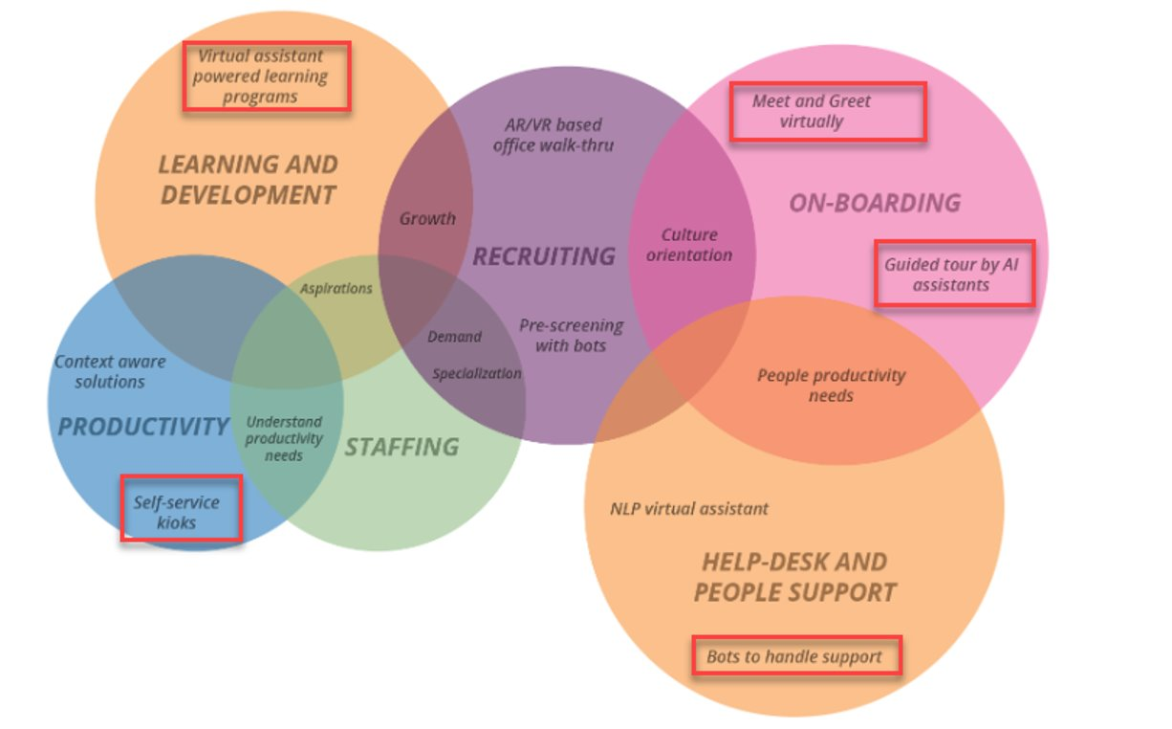
INTRODUCTION
Honda Virtual Assistant: Exploring implementing a virtual assistant on Microsoft Team or Skype platform, to help automate common internal tasks and reduce ticket loads.

Slide 4

INTRODUCTION
Research bot framework on the market
Bot framework analysis
Comparison
Decision making
Exploring customization the system

Slide 5






BOT FRAMEWORK ANALYSIS

Slide 6
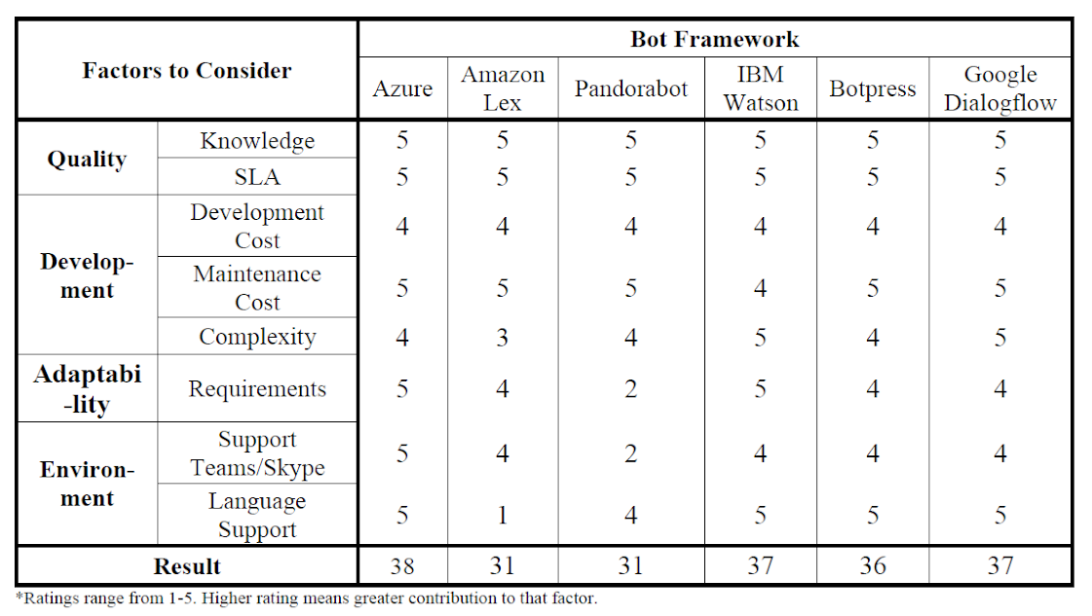
BOT FRAMEWORK ANALYSIS

Slide 7
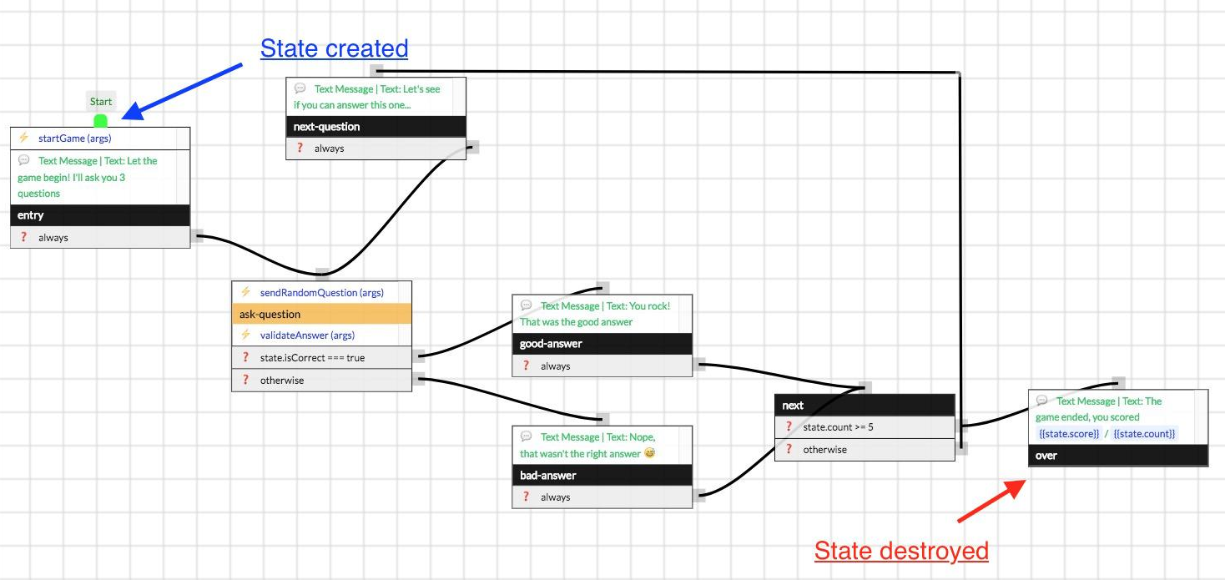
BOT FRAMEWORK ANALYSIS

Slide 8
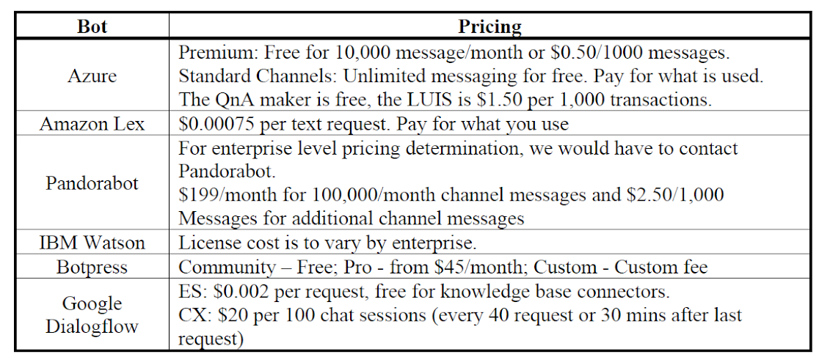
BOT FRAMEWORK ANALYSIS

Slide 9
BOT FRAMEWORK ANALYSIS
Note that the Microsoft decided to commit their focus on Microsoft Teams, focusing on the framework that is compatible with Teams will be wise in the long run.
Azure can be modified and customized better by editing the source code of the bot, while Dialogflow only provides UI interface to the user.
Azure acts better on the Microsoft Teams App function.
Honda is using Azure services for the moment. It may be easier to integrate the system better in the future.

Slide 10
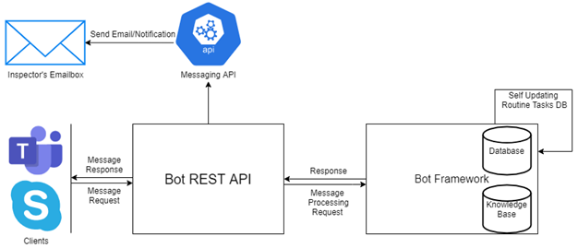
SYSTEM ARCHITECTURE
Login system
Bot Framework
Routine Task Identifier
Notification & Email Handler
Incident Reporter

Slide 11
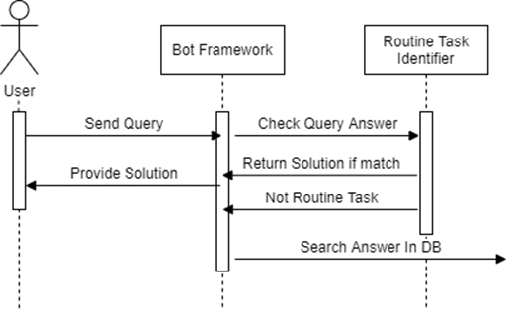
SYSTEM ARCHITECTURE
Use case 1: Query Process

Slide 12
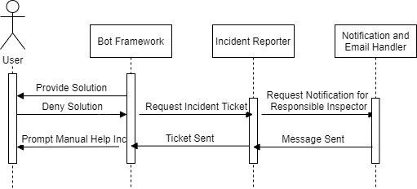
SYSTEM ARCHITECTURE
Use case 2: Incident Report

Slide 13
PROJECT HANDOFF
Login System, Notification & Email Handler
Login System - Check credential information in DB, request access code via Messaging API
Bot Framework & Routine Task Identifier
Need more training data, need more knowledge base file. LUIS updates.
Incident Reporter (ServiceNow)
Notes:
Jeremy Lin

Slide 14
RISKS & MEASURES
Team is unfamiliar with working environment
Pair Programming, resort to experienced people
Project falls behind schedule & Requirement Creep
Prioritize requirements, split tasks, use task tracker more efficiently; Drafting handoff document and setup instruction
Notes:
Jeremy Lin

Slide 15
DEMONSTRATION
Microsoft Teams;
Azure Bot Framework;
LUIS;
Azure Cognitive Search;
ServiceNow
Notes:
Jiankai

Slide 16
Thank you!

